Slide 2

ICP Presentation
Name: Sajag Shrestha
Roll no: NPI000172

Slide 3
Introduction
This project aims to create a covid-19 management system for Malaysia Red Crescent Society.
The management system is C programming based.
The program must allow it’s employees to create inventory, update donation quantities, search donation, display all donation and distributed quantities .
This is a program with non-graphical UI.
There are few assumptions made for the program.

Slide 4
Assumptions
The employees has access to the pre-determined username and password needed to enter the program.
The employees are to get the username & password correct before the fifth retry attempt.
The employees are to use different supply code for same supplies donated from a different country.
The employees are to memorize the supply code.
The employees are to know how to operate the program.

Slide 5
Pseudocode for main menu
Begin the function.
Declare choice.
Do while (1)
Display Main menu Layout Screen.
Input make a choice.
Switch statement on the choice
If choice = 1 then recorddonation().
If choice = 2 then updatedonation().
If choice = 3 then searchdonation().
If choice = 4 then alldonation().
If choice = 5 then deletedonation().
If choice = 6 then Display “Exiting....Goodbye ~(0v0)/” , Exit program.
Else print “Invalid Input, Enter value (0-6)”.
End switch statement.
End do while loop.
End function.

Slide 6
Flowchart for main menu

Slide 7
C Programming Concepts
Header files
User defined functions
Loop
Array
File Handling
Pointer
Structures

Slide 8
Header files
<stdio.h>
<conio.h>
<string.h>
<stdlib.h>

Slide 9
User defined functions
mainmenu()
recorddonation()
updatedonation()
searchdonation()
alldonation()
deletedonation()
bubblesort()
donorder()
donationlist()
distorder()
distributionlist()

Slide 10
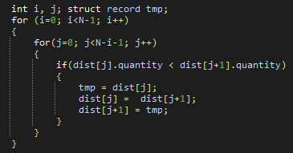
Loop
A loop is a statement that allows us to execute one or many statements repeatedly.
There are three types of loops in C programming: For Loop, While Loop and Do While Loop.
Loop within a loop is called a nested loop.

Slide 11
Array
An array is variable that can store multiple values of a single data type.
There are two types of array: single dimensional and multidimensional.

Slide 12

File Handling
File Handling refers to storing of data in a file using a program.
These are few operations that can be performed on a file in C:
open an existing file or a new file = fopen()
write data into an available file = fprintf()
read the data available in a file = fscanf()
write any string into the program file = fputs()
read any string from an available file = fgets()
used for closing the program file = fclose()

Slide 13
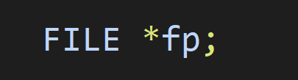
Pointer
Pointer are special variables that are used for storing addresses.
To represent the pointers we can use the operator ‘ * ’

Slide 14
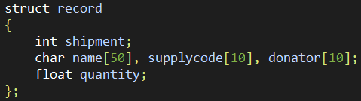
Structures
A structure Is a collection of variables of same or different types under a single name.
Before you create structure variable, you need to define it with the ‘struct’ keyword

Slide 15
Additional Features
Limited Login Retries.
Easy Navigation without exiting program.

Slide 16
Limitations
Limited quantity.
Low Security.
No option to search or delete distribution records.

Slide 17
Conclusion
This program helps the organization to manage donation records
This project helped a lot in understanding C programming in depth.
It provided general idea of how programming is carried out and broadened the logical and analytical thinking.

Slide 18
References
Kernighan, B. W., & Ritchie, D. M. (1988). The C programming language
www.w3schools.com. (n.d.). (Structures). [online] Available at: https://www.w3schools.com/c/c_structs.php
E Balagurusamy, (2012). Programming in ANSI C. Tata McGraw Hill Education Team
Portfolio Courses. (2021, Sept 4). Bubble Sort | C Programming Example [Video]. Youtube. https://www.youtube.com/watch?v=YqzNgaFQEh8&t=223s

